Slide 1


Causes of Deaths - Worldwide
(1990-2019)
Alessandro Platania
Gaia Sandra Schillaci
A. Y. 2021-2022
MASTER’S DEGREE in DATA SCIENCE for MANAGEMENT

Slide 2
Starting Dataset

Slide 3
The proposed report is based on a dataset containing information about the most common causes of deaths worldwide from 1990 to 2019.
The source of our data is https://www.kaggle.com/datasets/saleh846/causes-of-deaths-worldwide?resource=download.
There are 5 .csv files that compose the dataset:
above-age-70.csv: This file contains the causes of deaths of people aged above 70 years (limit included).
age-between-50-and-69.csv: This file contains the causes of deaths of people aged between 50 and 69 years (limits included).
age-between-15-and-49.csv: This file contains the causes of deaths of people aged between 15 and 49 years (limits included).
age-between-5-and-14.csv: This file contains the causes of deaths of people aged between 5 and 14 years (limits included).
under-age-5.csv: This file contains the causes of deaths of people aged below 5 years.

Slide 4
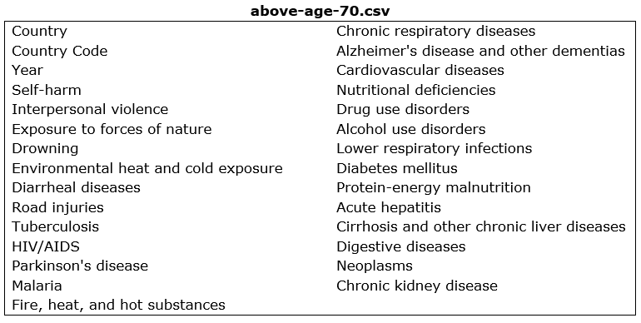
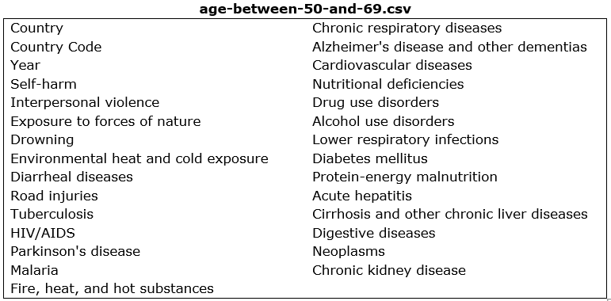
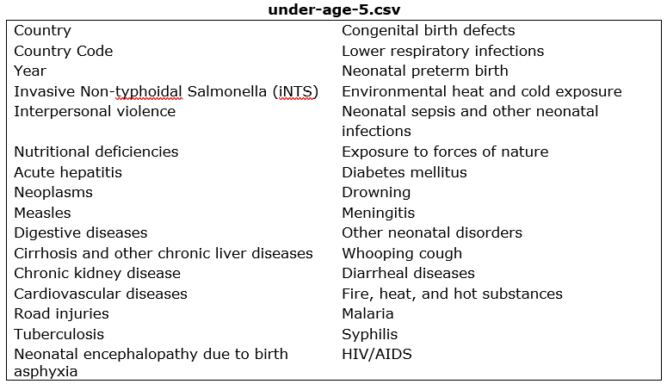
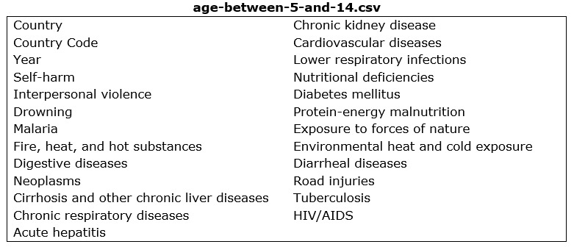
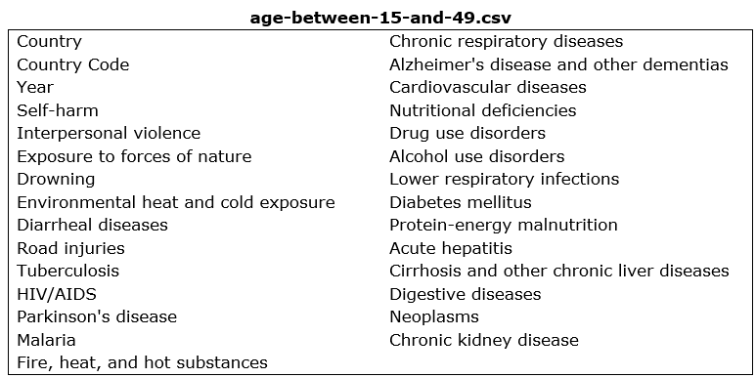

Slide 5

Business Questions
Considering the WHO regions:
a. Which is the most common cause of death?
b. In which WHO regions do we observe the highest number of deaths?
c. How did the number of deaths change from 1990 to 2019?
d. Taking into account the time frame, can we draw some insights?
Considering the age groups:
a. Which is the most common cause of death?
b. In which age group do we observe the highest number of deaths?
c. Where do we observe the highest number of deaths?
d. Taking into account the time frame, can we draw some insights?
Which is the general trend? Do we notice a decrease or an increase in deaths from 1990 to 2019?

Slide 6
ETL PROCESS

Slide 7
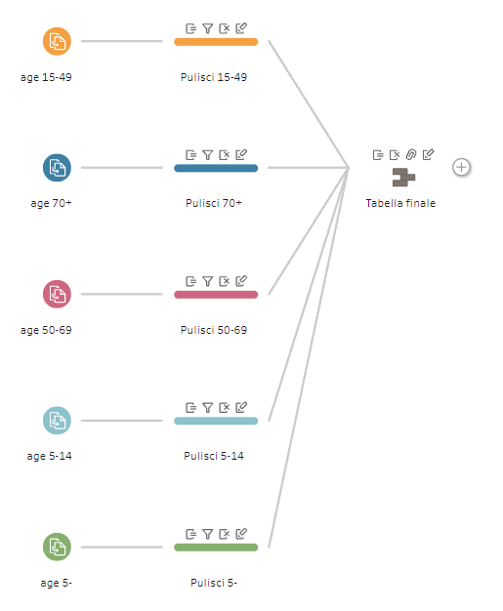
Before proceeding with the analysis, a preparation phase is mandatory to organize the dataset. ETL is a process that allows us to do this through the extraction, integration and cleaning of data from operational sources to eventually feed the data warehouse and it consists in three phases: Extraction, Transformation, Loading. The tool used is Tableau Prep Builder.

Slide 8
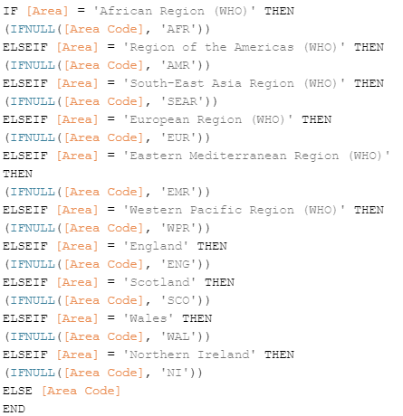
I. Cleaning
For each table: - Removed some values in the variable Country that didn’t match with the business questions. - Renamed Country and Country Code in Area and Area Code, since these variables also include the data of the 6 WHO regions (so to have a more general reference name).
- Since the 6 WHO regions and some countries did not have values in Area Code, we created a calculated field in which we put the values of the original Area Code variable and added the codes missing.
This new calculated field override the original variable.

Slide 9
- Transformed null values in numeric (= 0). Below, it is reported just an example of how this change has been done for all the variables.
II. Union
- Changed the variable “Table names” in “Age”
- Removed “England”, “Scotland”, “Wales” and “Northern Ireland” since we also have “United kingdom” that include these countries and by Default the maps of Tableau Desktop are set considering this setting.

Slide 10
Dimensional Fact Model

Slide 11
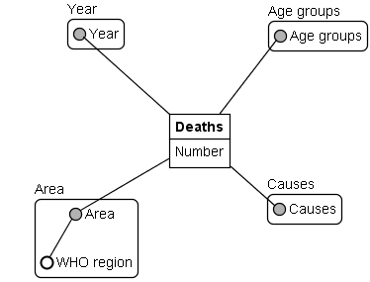
In our dataset, the fact is represented by Deaths, while its measure is Number. The dimensions are represented by Year, Area, Age groups and Causes. For the Area dimension we recognize a hierarchy composed of it and the dimensional attribute WHO region. Area -> WHO region

Slide 12
Sheets & Dashboards

Slide 13
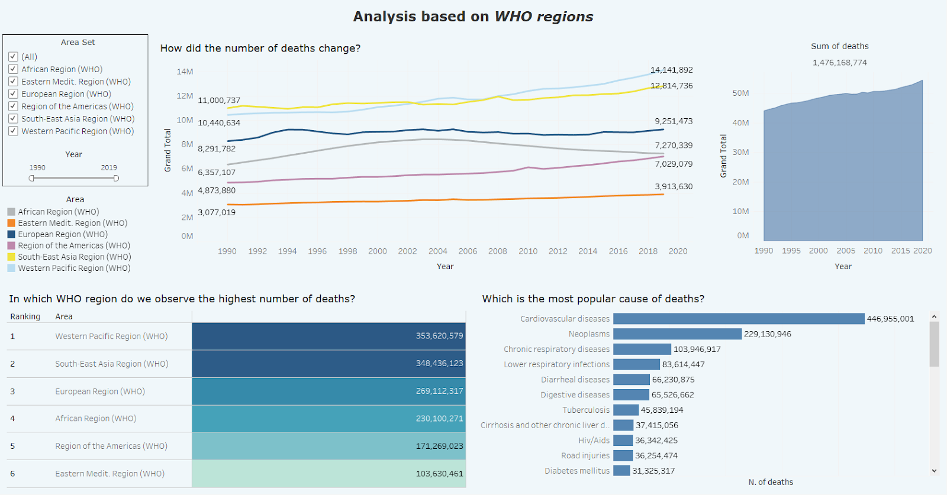
This dashboard aims to analyse the trend of the causes of deaths according to the WHO regions. There are five sheets: 1) N. of Deaths per Region, 2) Causes of deaths, 3) Changes of deaths throughout the years, 4) Sum of deaths, 5) Sum of deaths per year.
I. Dashboard – WHO regions
The box in the top left corner is the tool through which the dashboard is managed. We can select the regions to analyse and there is a slider that allows to filter the analysis according to some specific years.

Slide 14
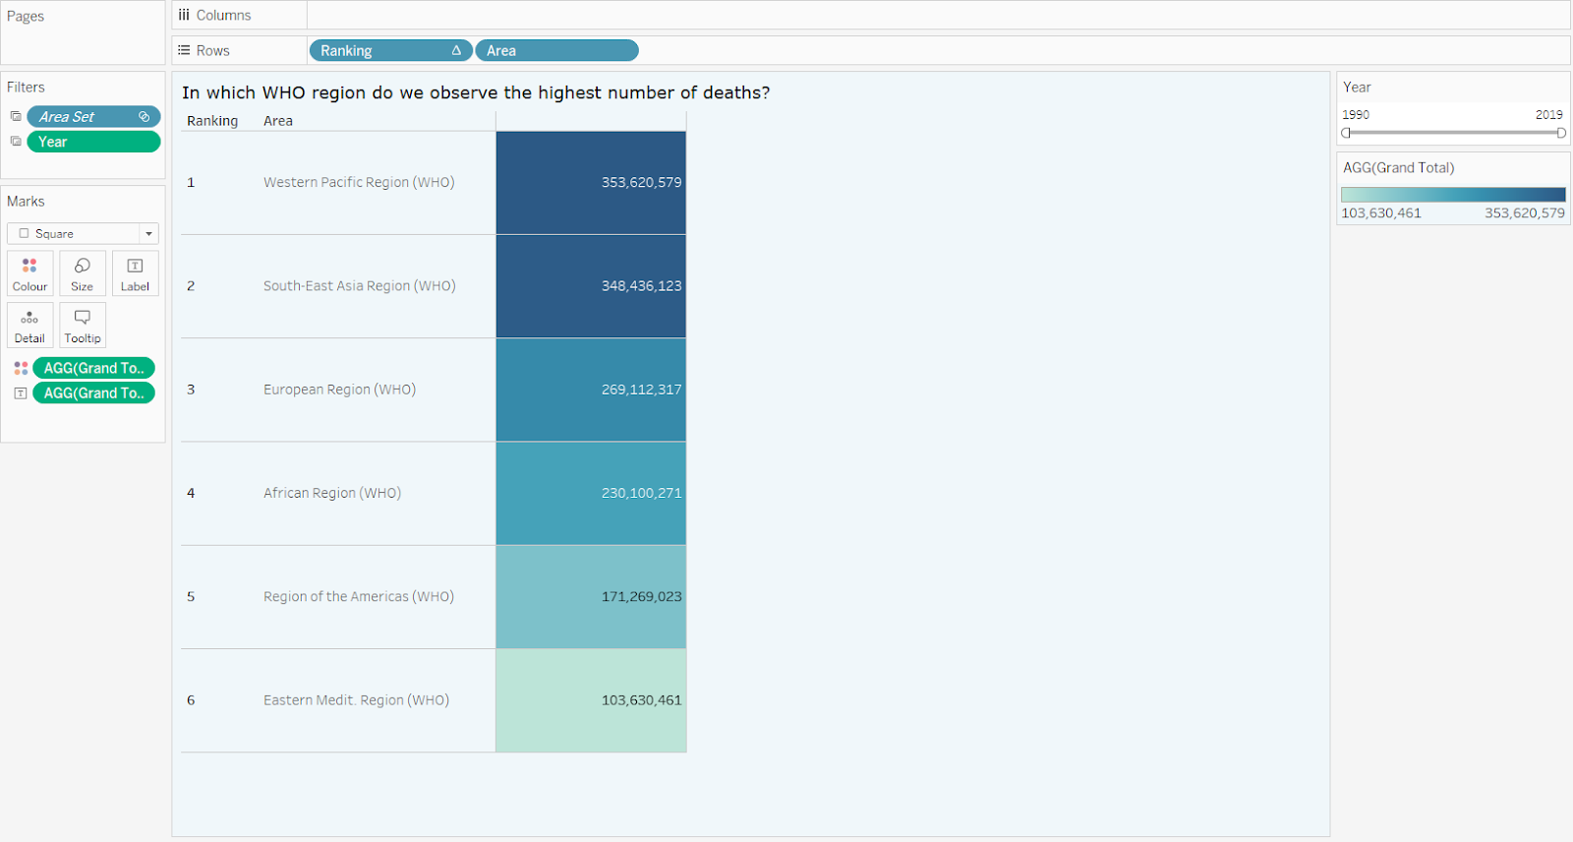
Sheet: N. of deaths per region
The N. of deaths per Region sheet shows each region that have been selected by the filter with the associated number of deaths. The regions are sorted considering this value and the colour applied (blue) changes its intensity through the full range, so that the darker the colour, the higher the n. of deaths is.
The measure used for this chart is obtained by setting the calculated field “Grand Total”:
SUM([Acute hepatitis])+SUM([Alcohol use disorders])+SUM([Alzheimer's disease and other dementias])+SUM([Cardiovascular diseases])+SUM([Chronic kidney disease])+SUM([Chronic respiratory diseases])+SUM([Cirrhosis and other chronic liver diseases])+SUM([Congenital birth defects])+SUM([Diabetes mellitus])+SUM([Diarrheal diseases])+SUM([Digestive diseases])+SUM([Drowning])+SUM([Drug use disorders])+SUM([Environmental heat and cold exposure])+SUM([Exposure to forces of nature])+SUM([Fire, heat, and hot substances])+SUM([Hiv/Aids])+SUM([Interpersonal violence])+SUM([Invasive Non-typhoidal Salmonella (iNTS)])+SUM([Lower respiratory infections])+SUM([Malaria])+SUM([Measles])+SUM([Meningitis])+SUM([Neonatal encephalopathy due to birth asphyxia and trauma])+SUM([Neonatal preterm birth])+SUM([Neonatal sepsis and other neonatal infections])+SUM([Neoplasms])+SUM([Nutritional deficiencies])+SUM([Other neonatal disorders])+SUM([Parkinson's disease])+SUM([Protein-energy malnutrition])+SUM([Road injuries])+SUM([Self-harm])+SUM([Syphilis])+SUM([Tuberculosis])+SUM([Whooping cough])

Slide 15
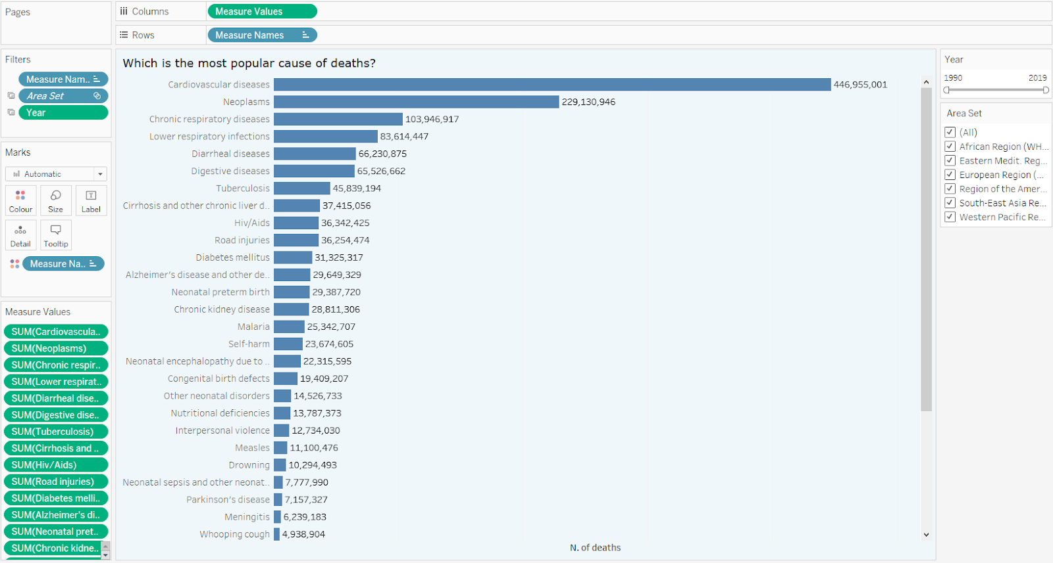
Sheet: Causes of Deaths
The Causes of deaths sheet is composed of a bar chart that shows the causes of deaths from the most popular to the least.
We used just a single tone of blue since we found it better to visualize the available data.
To highlight just the six WHO regions, we created a set called Area Set that is composed just of these regions.
The option to show the mark labels is ticked.

Slide 16
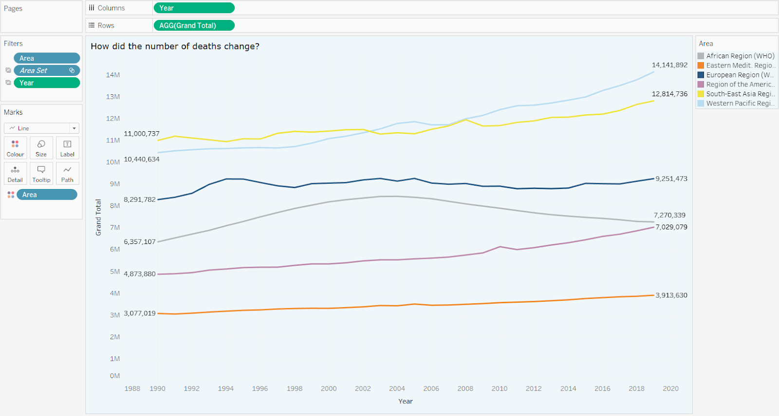
Sheet: Changes of deaths throughout the years
The Changes of deaths throughout the years sheet shows how the number of deaths changed over time.
Each colour is associated with a different region. We opted for a line chart since our goal was to focus the attention on the changes over the period.
As we did before, we used the Area Set to highlight just the WHO regions.

Slide 17
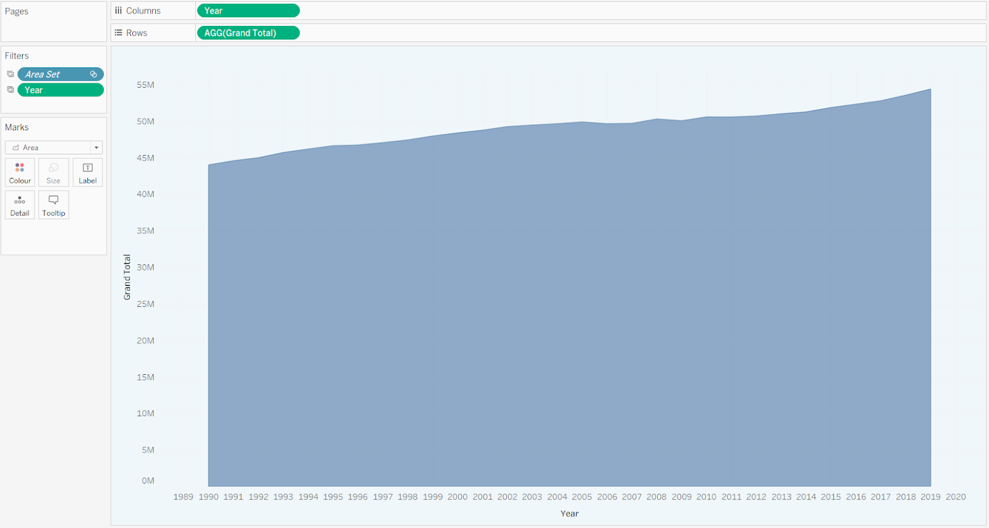
Sheet: Sum of Deaths per year
This sheet shows the number of deaths per year, according to the values of the filters.
Differently from the previous sheets, here the aim is to underline the changes over the period of the sum of the number of deaths of the regions considered.
Hovering the pointer in a part of the graph would lead to see the sum of deaths of the WHO regions marked in a specific year.

Slide 18
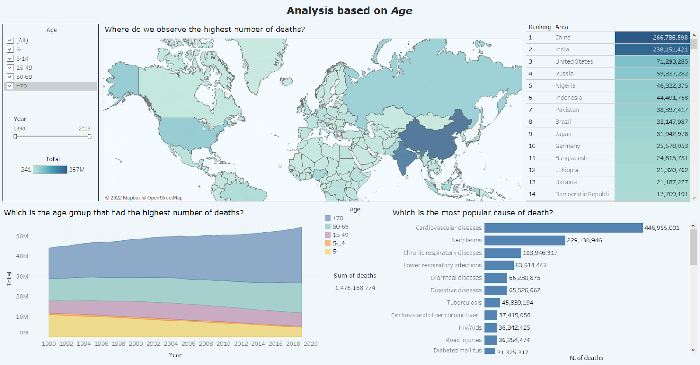
This dashboard aims to analyse the trend of the causes of deaths according to the age groups. There are six sheets: Map of Deaths, Causes of deaths per age, N. of Deaths per Age area chart, N. of deaths Rank country, N. of deaths line chart country tooltip, Sum of Deaths per age.
II. Dashboard – Age
The box in the top left corner is the tool through which the dashboard is managed. We can select the age groups that we want to analyse and there is a slider that allows to filter the analysis according to some specific years.

Slide 19
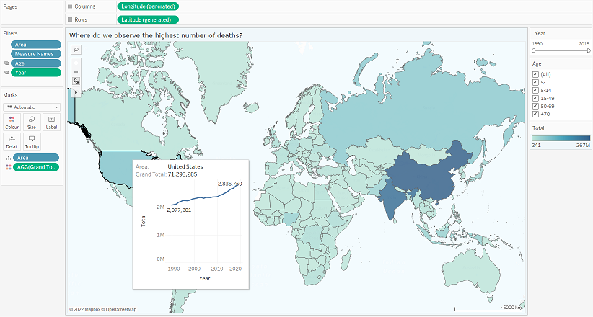
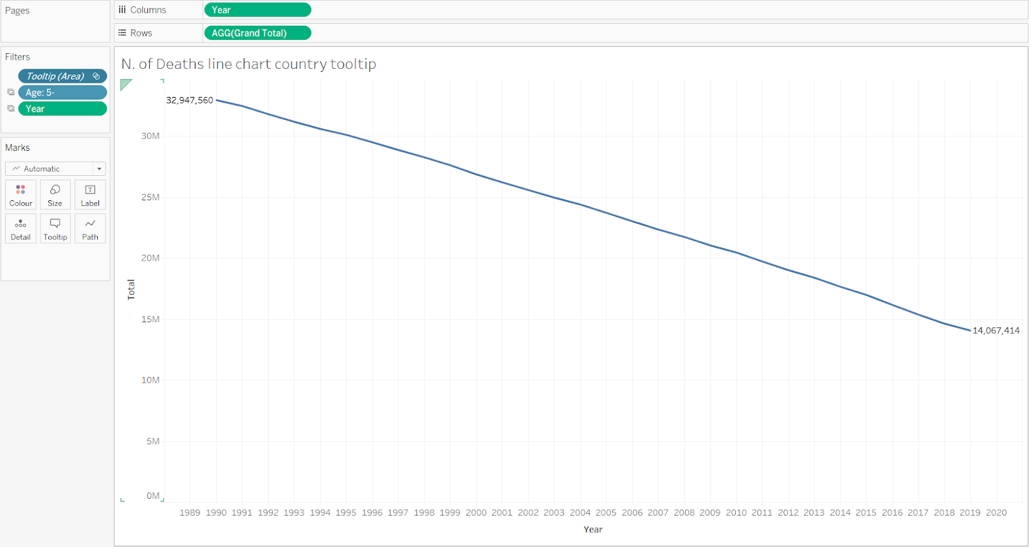
Sheet: Map of Deaths + N. of Deaths line chart country tooltip
This sheet is based on a geographical map in which, according to the filters, we can observe how the number of deaths for each country changes.
Moreover, if we move the pointer on a country, a specific tooltip containing some interesting information is available: apart from showing the total of deaths for that country, there is a line chart that gives info about the changes over the years of the number of deaths (obviously even this chart is managed according to the period considered).

Slide 20
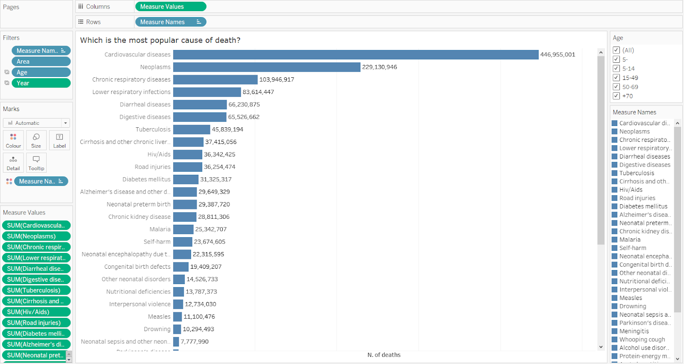
Sheet: Causes of Deaths per age
This sheet is composed of a bar chart that shows the causes of deaths from the most popular to the least.
We used just a single tone of blue since we found it better to visualize the available data. The option to show the mark labels is ticked.

Slide 21
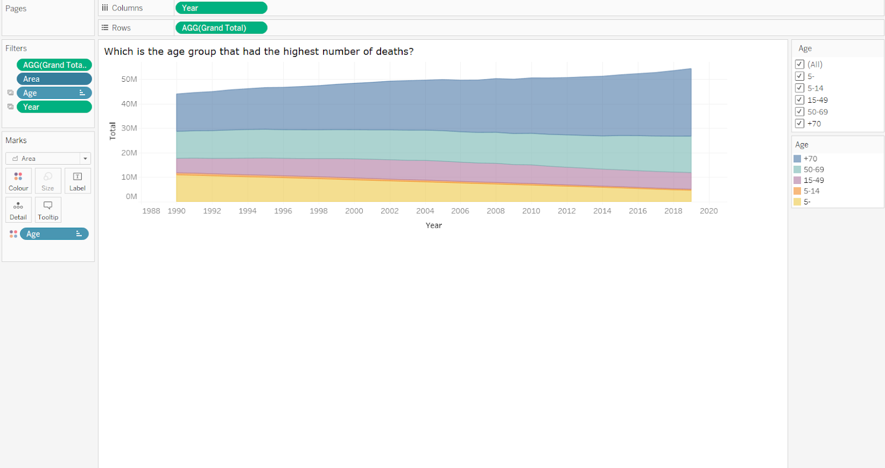
Sheet: N. of Deaths per age area chart
This sheet shows the number of deaths for each age group over the period considered.
We used a stacked area chart to track both the total value of the groups considered and to understand the breakdown of that total by groups.
Comparing the heights of each segment of the curve allows us to get a general idea of how each subgroup compares to the others in their contributions to the total.

Slide 22
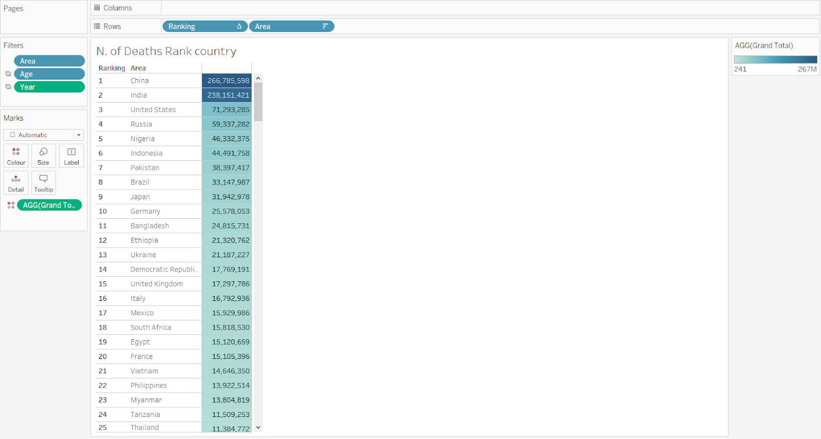
Sheet: N. of Deaths rank country
This sheet focuses on showing in terms of numerical values the rank of the countries in which the highest number of people died.
A gradient of blue has been used to underline the countries that are ranked from the top to the bottom.

Slide 23
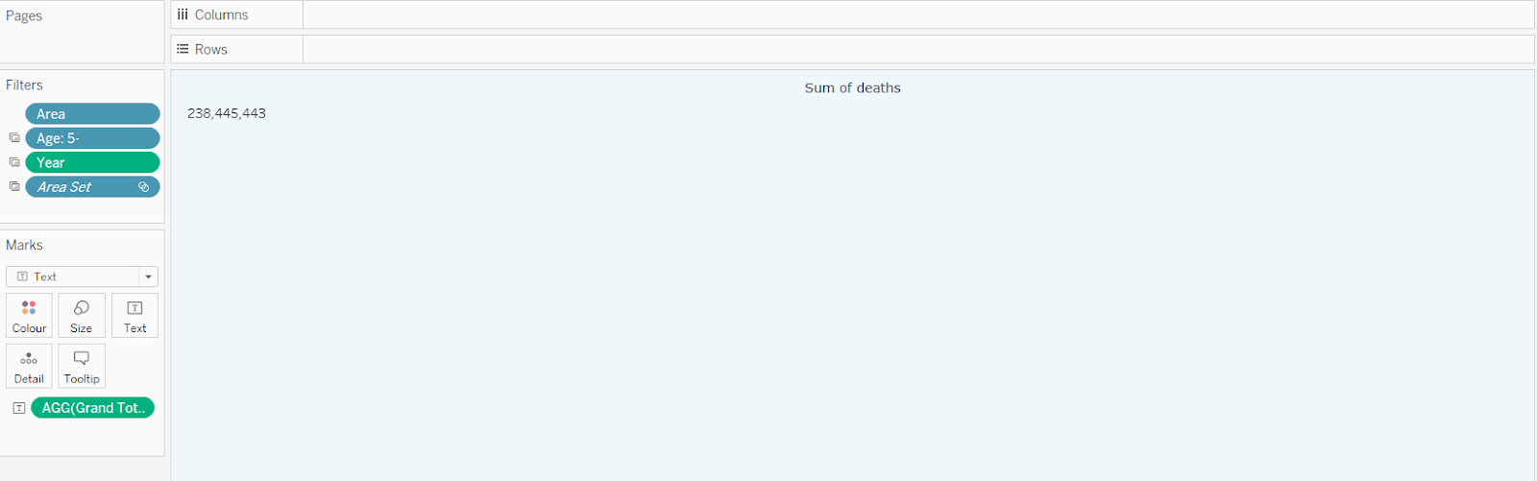
Sheet: Sum of Deaths per age
This sheet shows the global total number of deaths according to the filters.

Slide 24

Colour Blindness Test

Slide 25
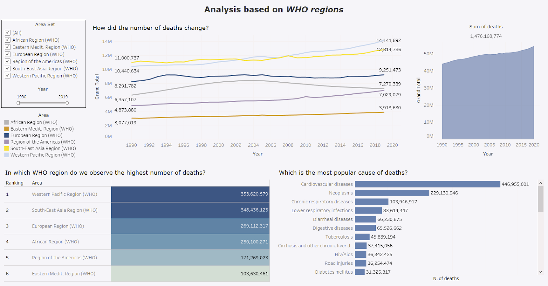
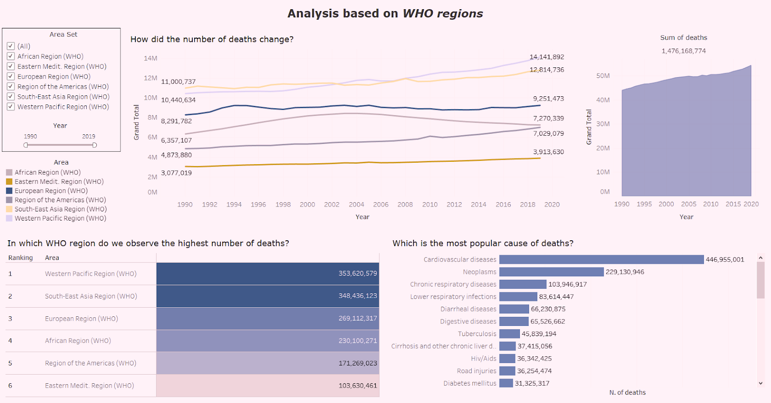
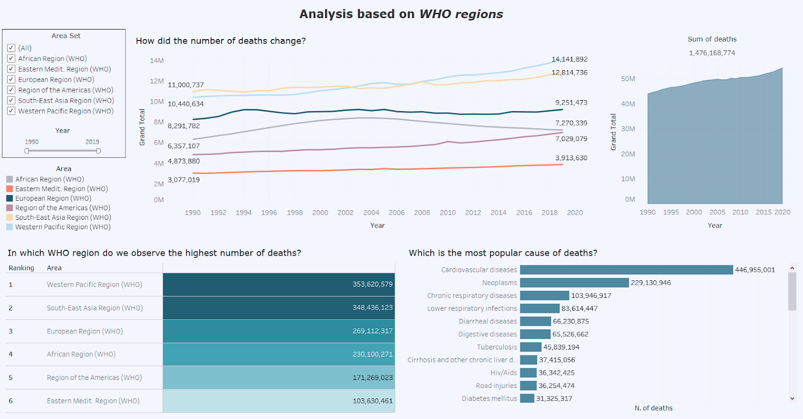
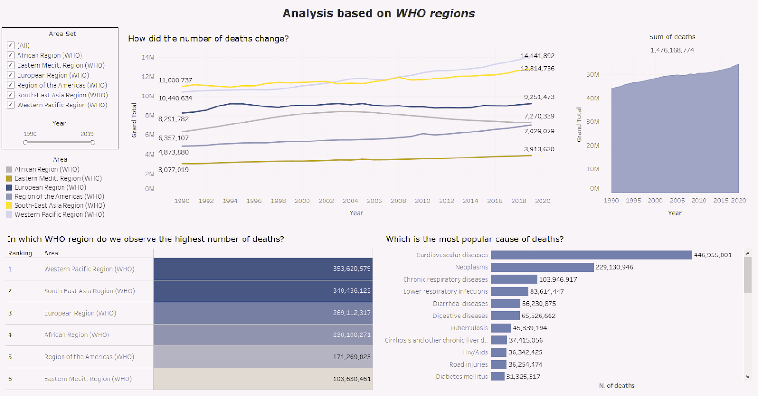
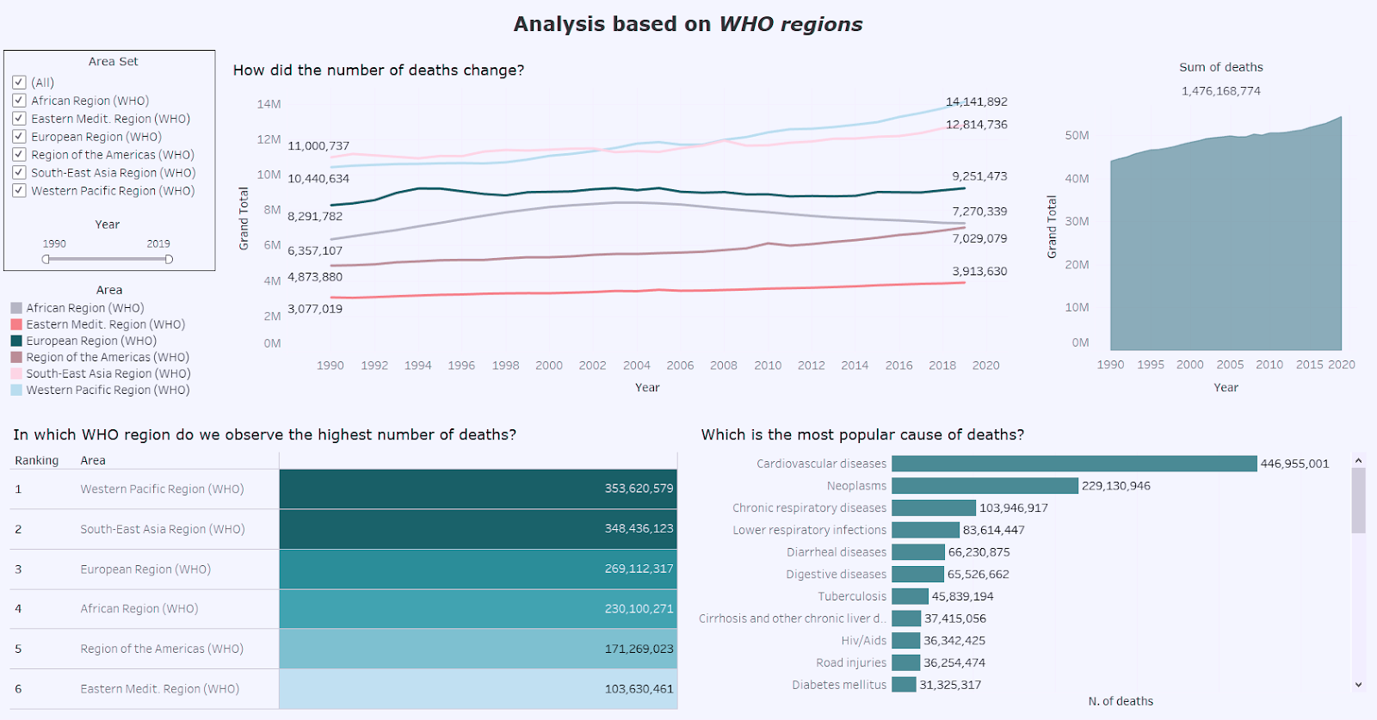
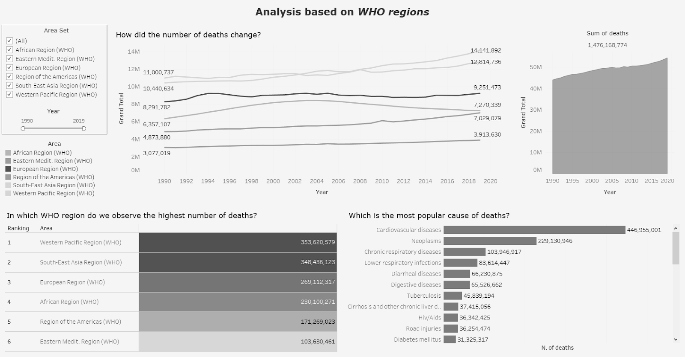

I. Dashboard – WHO regions
Anomalous Trichromacy
Red-Weak
Green-Weak
Blue-Weak
Dichromatic view
Red-Blind
Green-Blind
Blue-blind
Monochromatic view
Monochromacy
Blue Cone Monochromacy

Slide 26
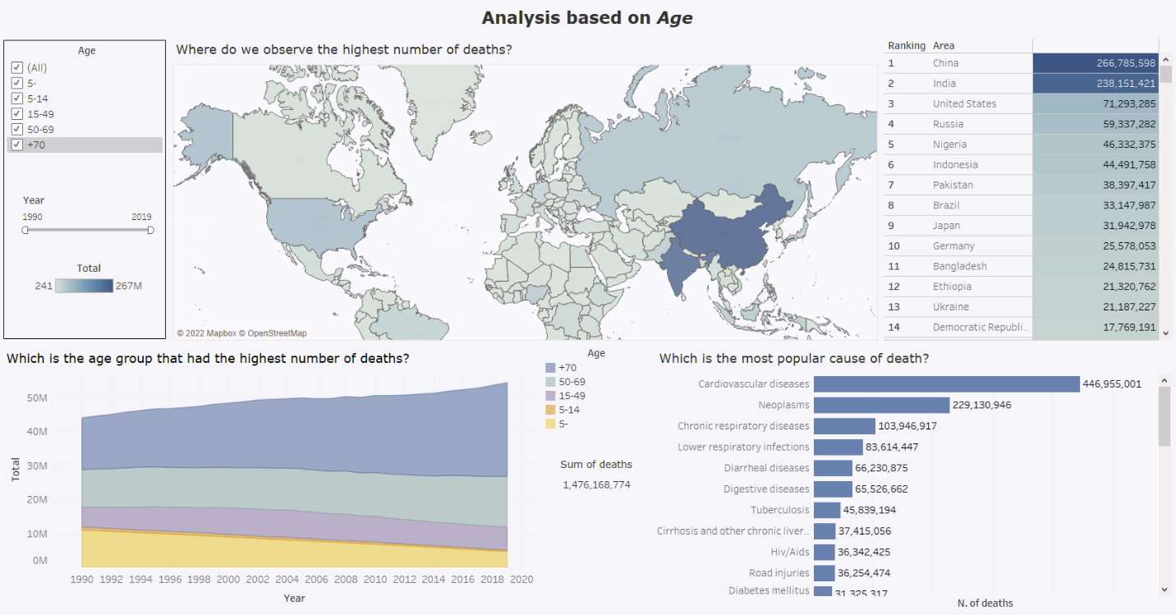
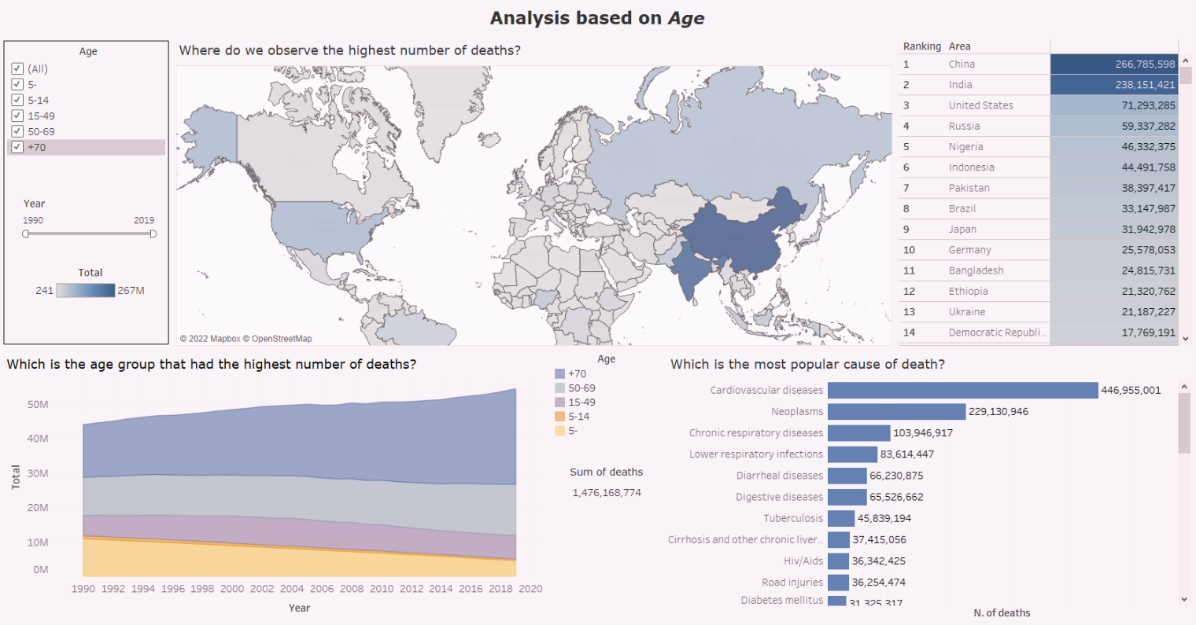
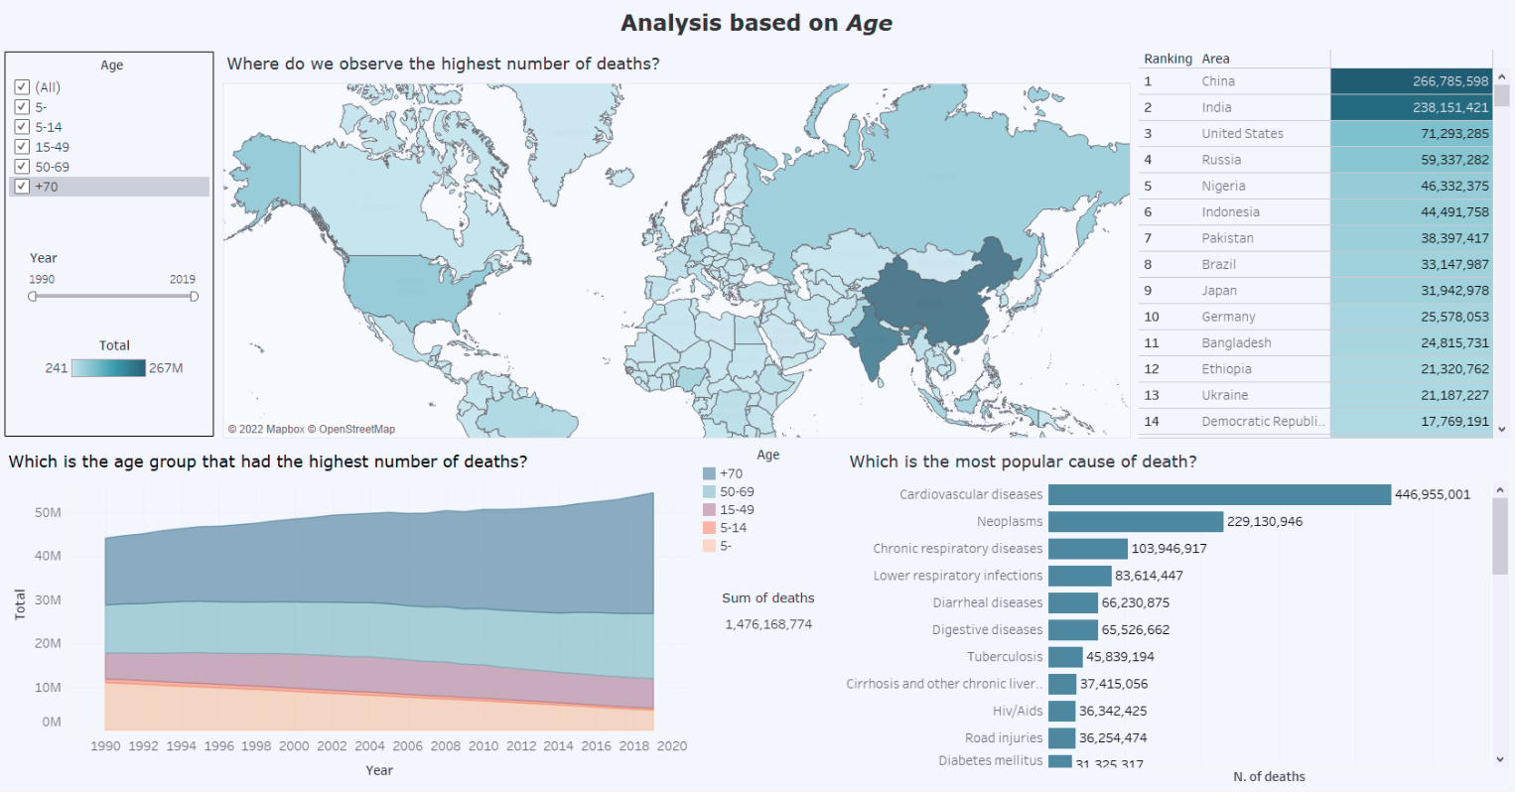
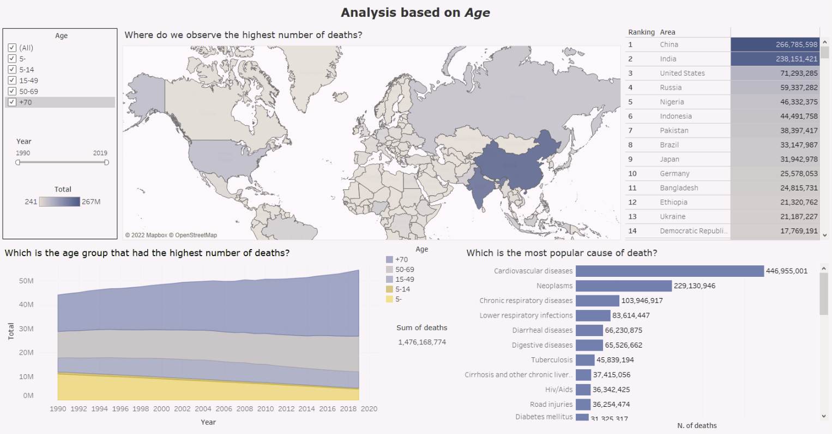
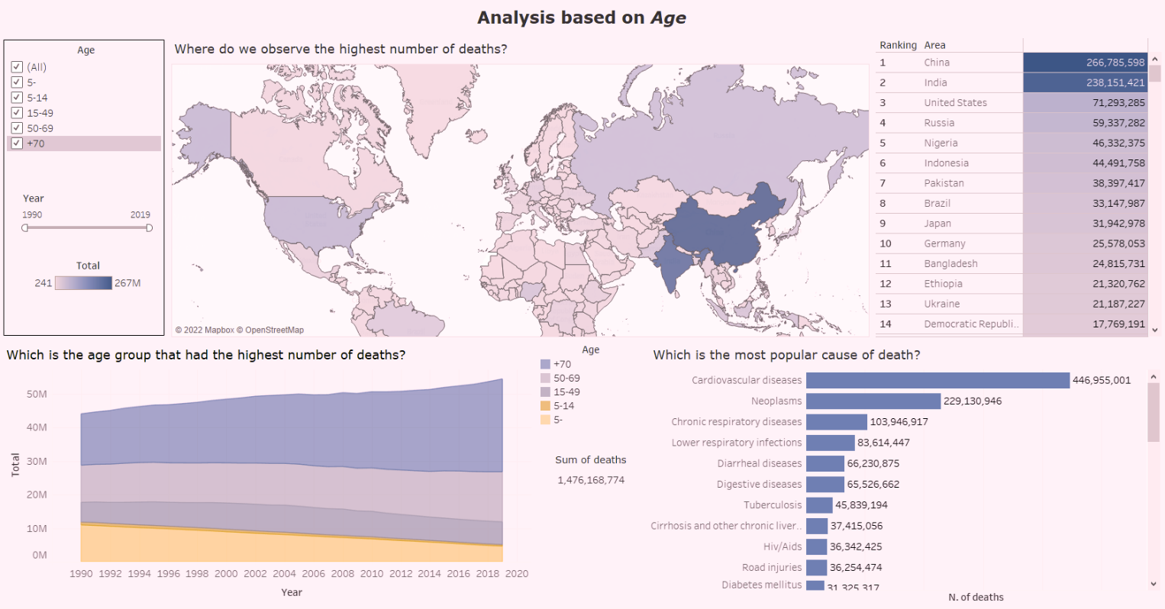
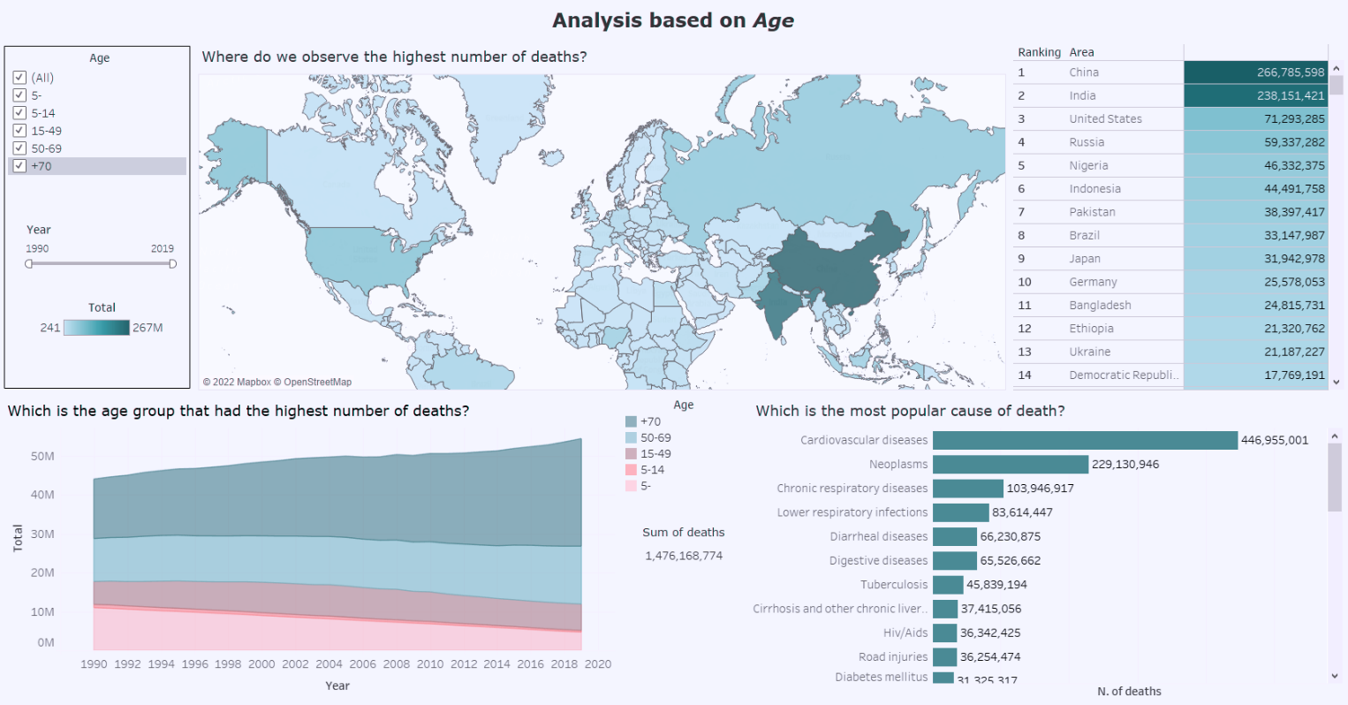
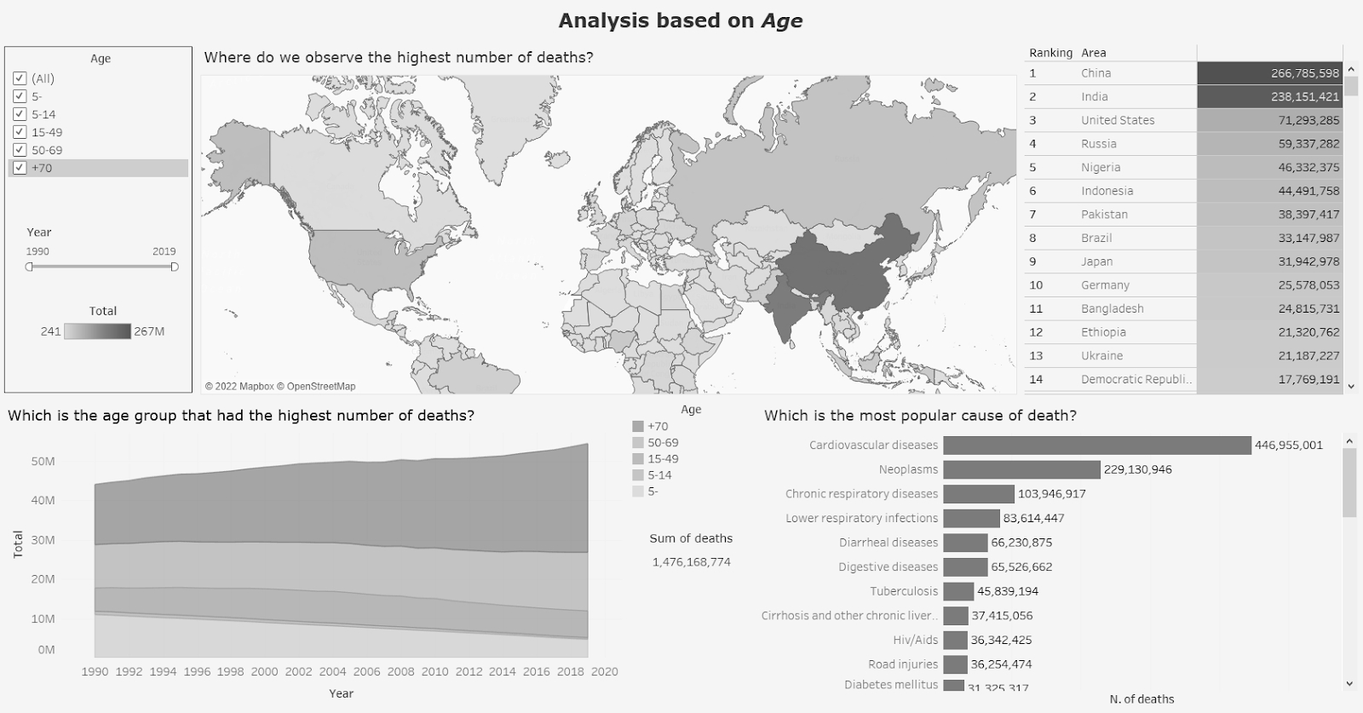

II. Dashboard – Age
Anomalous Trichromacy
Red-Weak
Green-Weak
Blue-Weak
Dichromatic view
Red-Blind
Green-Blind
Blue-blind
Monochromatic view
Monochromacy
Blue Cone Monochromacy

Slide 27
Answers to Business Questions

Slide 28
Considering the WHO regions:
Which is the most common cause of death?
Considering the last 30 years, we can observe that in the African Region Hiv/Aids has been the most popular cause of death
For the others five WHO regions cardiovascular diseases represent by far the biggest reason why people die. However, if we restrict the time frame, we can notice that even in the African Region in the last ten years (2010-2019) cardiovascular diseases have been preponderant, while HIV/Aids in the years between 1990 and 2009 was at the top of the chart.
In which WHO regions do we observe the highest number of deaths?
The Western Pacific Region has the highest number of deaths, followed by South-East Asia Region with.
Over the years, Western Pacific Region and South-East Asia Region have always been at the top of the chart, inverting their position in 2002 and having very close values between 2006 and 2008.
How did the number of deaths change from 1990 to 2019?
Generally speaking, we observe for every region an increase in terms of number of deaths over these 30 years (except the African and the European region where a small decrease is detectable).
The highest increase in percentage is that of the Region of the Americas, passing from 4.8 M in 1990 to 7 M in 2019.
d) Taking into account the time frame, can we draw some insights?
Some interesting considerations have been made in the previous answers. According to the needs, the flexibility of the dashboards allows to see more in depth how over the time each element changed.

Slide 29
Considering the age groups:
Which is the most common cause of death?
For the age group 5- the most common cause of deaths are lower respiratory infections, followed by some problems that may arise for new-born children.
For the age group 5-14 road injuries is at the top, with diarrheal diseases and drowning ranked second and third.
For all the others age groups we observe that cardiovascular diseases and neoplasms are at the top; Hiv/Aids are in the third position for people between 15 and 49, while for people older than 50 chronic respiratory diseases occupy that position.
In which age group do we observe the highest number of deaths?
The highest number of deaths is related to people that are older than 70, with a relevant positive trend over the years. Considering the others age group, we can observe that there has been a decrease of deaths.
Where do we observe the highest number of deaths?
For the age group 5-, we observe the highest number of deaths in India (more than 50 million).
For the age group 5-14 the ranking shows India, China and Bangladesh as top 3, with India leading with more than the double of deaths compared to the second place (5 million and 2.2 million).
For the age group 15-49 India, China and Russia have the highest values even though Russia is far from the numbers of the other two countries (42.6 M vs 32 M vs 9.7 M).
For the age group 50-69 China, India and Russia still lead the ranking.
For the age group +70 in the third position United States takes the place of Russia (with other positions the same as the age group 50-69).

Slide 30
Taking into account the time frame, can we draw some insights?
For instance, considering the age group 5- and modifying the time frame to visualize just the last 10 years (2010-2019) we can see how countries like China have cut the death toll by more than half compared to the previous decade (China passed from 3.5 M in the period 2000-2009 to 1.5M between 2010 and 2019).
Considering the age group 70+, for most countries we see an increase in number of deaths but there are some exceptions: while China, Japan, India experienced a relevant increase in the last decade (an increase of around +33% for the first two and +23% for the last one), US had a small increase (+7%) and Russia had even a decrease (-4.4%).
Which is the general trend? Do we notice a decrease or an increase in deaths from 1990 to 2019?
The number of total deaths of the world has increased with an almost steady positive trend, passing from around 44 M in 1990 to 54M in 2019.
Some extra considerations…
As general knowledge we know that the world population is constantly increasing: therefore, some considerations on the decrease or increase of some of the causes of deaths according to how for each country the population changed would have led to some interesting conclusions.

Slide 31
THANK YOU
Alessandro Platania & Gaia Sandra Schillaci

